Slide 1
TL
TicketLeader
Business Profile & Investment Case
Fair Queues. Zero Bots. Superior Fan Experience.
BisonHacks 2026 · Confidential

Slide 2
THE PROBLEM
The Ticketing Industry Is Broken
40–60%
96%
28%
$31M
of high-demand tickets bought by bots
of on-sale traffic is bots at peak events
of face value lost to Ticketmaster fees
FTC BOTS Act penalty (2021 enforcement)
Queue-it, 2024
Arkose Labs, 2024
NGPF / Pops & Hisses
FTC.gov
Fans priced out. Artists lose control. Venues bleed margin to monopoly fees. The BOTS Act mandates compliance — yet no affordable platform delivers it end-to-end.

Slide 3
THE SOLUTION
TicketLeader: Fair Queue SaaS for Venues
🤖
🎯
🏟️
📊
Multi-Layer Bot Detection
AI Trivia Gate
3D Stadium Experience
Trust Score Queue Engine
Behavioral tracking · IP flagging Response timing · WebAuthn biometric
Gemini-powered artist questions Proves humanity before queue entry Dynamic — never the same twice
80,000-seat interactive viewer Seat finder with TTS directions Parking & accessibility routing
Bronze → Platinum tiers Fans earn position via gameplay Real-time WebSocket updates
White-label · BOTS Act compliant out-of-the-box · No Ticketmaster dependency

Slide 4
COMPETITIVE MOAT
Why We Win — And Why It's Hard to Copy
The Only AI Trivia Gate
Feature
TL
TM
Evbrite
AXS
No competitor uses AI-generated, artist-specific questions as human verification. Powered by Gemini 2.5 Flash — questions are dynamic, impossible to automate.
Bot detect (behavioral)
✓
~
✗
~
AI trivia gate
✓
✗
✗
✗
Full Behavioral + Biometric Stack
Mouse movement, scroll cadence, click timing, and WebAuthn Face ID/Touch ID combine into a trust score. Bots cannot fake real human physical behavior.
Biometric verify
✓
✗
✗
✗
3D stadium viewer
✓
✗
✗
✗
3D Stadium + Accessibility Navigation
Interactive 80K-seat stadium with real section routing, TTS directions, and parking guidance. A fan engagement feature no competitor has built.
Trust queue
✓
✗
✗
✗
White-label B2B
✓
✗
✓
✓
Trust-Score Queue = Retention Moat
Fans accumulate score across events. Switching platforms means losing their ranking. The longer they stay, the deeper the lock-in — for both fans and venues.
Fee % of ticket
1.5–2%
19–28%
3.7%
N/A
TM=Ticketmaster · TL=TicketLeader · ~=Partial

Slide 5
MARKET OPPORTUNITY
$39.8B Market Growing to $99.3B by 2032
$39.8B+ TAM (Total Addressable)
Global online event ticketing (2024) · CAGR 8.9%
$4.0B SAM (Serviceable-Addressable)
Mid-market venues open to alternative platforms
$120M SOM (Serviceable-Obtainable)
Year 3 realistic capture at 50+ venues
Source: Grand View Research · Verified Market Research 2024

Slide 6
PRICING MODEL
Per-Ticket SaaS — We Undercut & Outperform
★ MOST POPULAR ★
Starter
Pro
Enterprise
$1.50/ticket + 2%
$1.00/ticket + 1.5%
Custom ~0.75% + fee
Small venues < 5K capacity
Mid venues 5K – 20K seats
Arenas & stadiums 20K+ capacity
vs. Competitors
Ticketmaster
Eventbrite
TicketLeader
19–28% of ticket
3.7% + $1.79/ticket
1.5–2% + $1.00–1.50
Sources: NGPF, Capterra, Pops & Hisses (2024–2025)

Slide 7
INVESTMENT PLAN
Lean Year-1 Budget: $43,200+
Year 1 — Pre-Seed Operating Costs
Funding Roadmap
Line Item
Monthly
Annual
Phase 1 · Year 1
Cloud Infrastructure (Render/AWS)
$1,500/mo
$18,000+
Pre-Seed
$53K+
Marketing & Outreach
$667/mo
$8,000+
3 pilot venues · refine detection · collect data
Legal, Entity & IP
one-time
$8,200+
Phase 2 · Year 2
Tooling, APIs & Misc
$750/mo
$9,000+
Seed Round
$600K
TOTAL
$43,200+
10 venue contracts · $500K ARR target
'+' = floor estimate. Actual costs scale with growth.
Phase 3 · Year 3
Series A
$2–4M
50+ venues · $3M+ ARR · 5 metro markets

Slide 8
BREAK-EVEN ANALYSIS
Profitable at 36,000 Tickets/Month
Monthly Fixed Costs
Avg. Revenue / Ticket
Tickets to Break Even
~$3,600+
$1.25
36,000
lean infrastructure + ops
blended Starter/Pro rate
tickets per month
Equivalent Events
Break-Even ARR
Timeline
~12
$540K
Month 18–24
mid-size events/month
annualized run rate
post-launch estimate
70–80% gross margin typical for SaaS · Lighter Capital 2025 Benchmarks

Slide 9
BREAK-EVEN: STADIUM CONTEXT
36,000 Tickets = Just a Handful of Events
BREAK-EVEN TARGET
Venue
Capacity
Type
Events to Break Even
36,000
MetLife Stadium (NJ)
82,500
NFL
1 event ★☆☆☆☆
AT&T Stadium (Dallas)
80,000
NFL
1 event ★☆☆☆☆
tickets sold in a month
At $1.25 avg. → $45,000 revenue → covers all operating costs
SoFi Stadium (LA)
70,240
NFL
1 event ★☆☆☆☆
Allegiant Stadium (Las Vegas)
65,000
NFL
1 event ★☆☆☆☆
That's not a market. That's a single weekend.
Madison Square Garden (NYC)
20,789
Arena
2 events ★★☆☆☆
United Center (Chicago)
20,917
NBA/NHL
2 events ★★☆☆☆
Kaseya Center (Miami)
19,600
NBA
2 events ★★☆☆☆
Bridgestone Arena (Nashville)
17,500
NHL
3 events ★★★☆☆
Mid-size Amphitheater
12,000
Concert
3 events ★★★☆☆
University Arena (avg.)
8,000
College
5 events ★★★★★
★ = 1 sold-out event needed to break even · Capacities: Wikipedia / Statista 2024

Slide 10
GO-TO-MARKET
Land Venues. Prove It. Scale.
01
02
03
04
Target
Pitch
Pilot
Channel
Independent venues frustrated with Ticketmaster exclusivity & high fees. Theaters, amphitheaters, university arenas.
"Keep 20% more per ticket. Zero bots. BOTS Act compliant out of the box."
First 3 venues FREE for 6 months. Testimonials + usage data to sharpen the model.
Direct venue sales · Pollstar & INTIX conferences · Artist manager referrals.
Year 1: 3 pilots · Year 2: 10 contracts · Year 3: 50+ venues across 5 metro markets

Slide 11
REGULATORY TAILWIND
The Law Is on Our Side
⚖️ BOTS Act (2016)
🏛️ DOJ Antitrust vs. Live Nation
Federal law signed by President Obama. Makes automated ticket purchases illegal. FTC enforced $31M judgment in 2021 (reduced to $3.7M on inability to pay). Empowers state AGs to act on behalf of residents — multi-state enforcement. TicketLeader's bot detection stack is BOTS Act compliance infrastructure.
DOJ filed antitrust suit against Live Nation/Ticketmaster. Forced to loosen hold on reserved-seating market. Creating space for AXS, SeatGeek — and TicketLeader.
📋 FTC Compliance Reminder (April 2025)
FTC issued a formal refresher warning all ticket sellers to audit their compliance posture. Venues using TicketLeader are automatically compliant — a legal shield and sales differentiator.

Slide 12
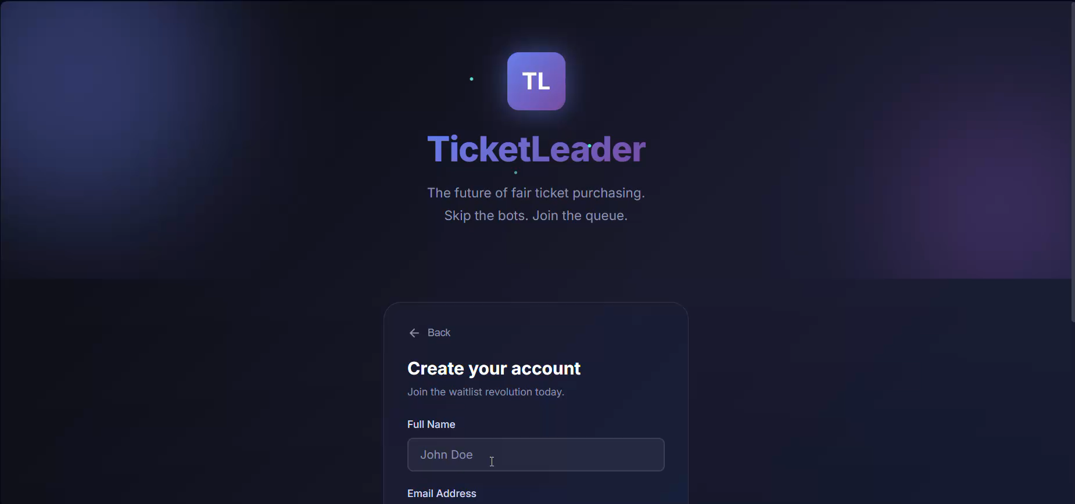
LIVE DEMO — AUTHENTICATION
Seamless Login & Signup Experience
⚡ Zero-Friction Auth
▶ DEMO VIDEO
Clean two-step flow — choose Sign In or Create Account. No unnecessary fields, no CAPTCHA friction.
🔒 JWT Security
Tokens expire after 7 days. bcrypt password hashing at 10 rounds. Industry-standard security from day one.
🎮 Instant Queue Access
After login, users land directly in the Live Queue dashboard — one tap to join any event.
Authentication · login_signup.mp4

Slide 13
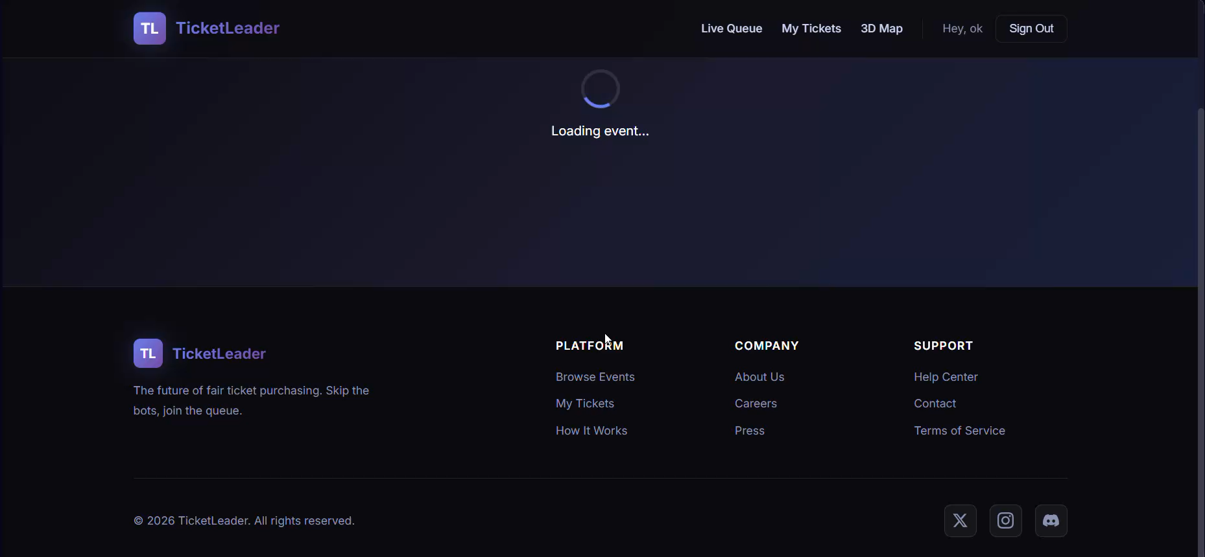
LIVE DEMO — QUEUE SYSTEM
Real-Time Fair Queue in Action
🎯 Trivia Gate
▶ DEMO VIDEO
Artist-specific AI questions verify humanity before entry — bots can't pass. Questions cycle so no two sessions are the same.
📊 Trust Score Engine
Answer trivia, play polls, wait patiently — all earn Trust Points. Gold & Platinum members get priority position.
⚡ WebSocket Live Updates
Position, estimated wait, and trust score update in real time. No refresh needed — fans always know where they stand.
Live Queue System · live_queue.mp4

Slide 14
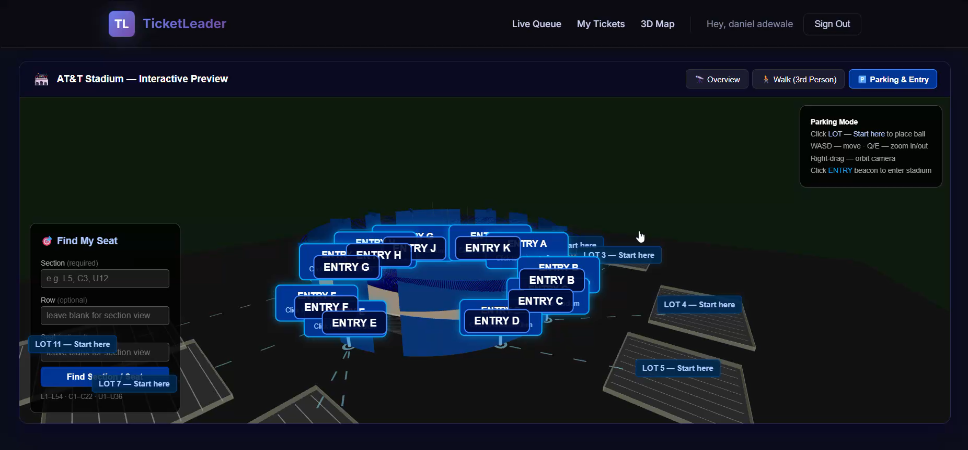
LIVE DEMO — 3D STADIUM & ACCESSIBILITY
Find Your Seat. Find Your Parking. Effortlessly.
♿ Accessibility First
▶ DEMO VIDEO
Fans with mobility needs can identify the shortest walking route to their section before they even arrive at the venue.
🚗 Parking Guidance
Which lot? Which entrance? The 3D viewer maps parking to seat — reducing congestion and stress for every attendee.
🗣️ Spoken TTS Directions
Turn-by-turn audio directions read aloud in the app. Hands-free navigation for fans with visual impairments.
3D Seat Finder & Wayfinding · ball_movement.mp4

Slide 15
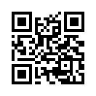
TL
The Future of Fair Ticketing
is already built.
$3.75M
Month 18–24
70–80%
ARR at Scale
Break-Even
Gross Margin
LIVE-DEMO: ticket-leader.vercel.app/
React · Node.js · MongoDB · Three.js · Google Gemini 2.5 Flash

Slide 16

Thank you!
Made by: Daniel Adewale,
Mason Brogden,
Joseph Lewis,
Solomon Shasanmi

